Slide 1

N
Northwind Data Analysis
From SQL query, to output, to visual insight
Eng. Ramadan Mahmoud
Data Analysis Report • Northwind Traders

Slide 2
Analysis Overview
Five questions, each traced from raw SQL to final chart
1
Daily order distribution across employees
2
Most loyal high-volume (VIP) customers
3
Employee footprint vs. customer density by city
4
Best-selling products
5
Employees linked to shipment delays

Slide 3
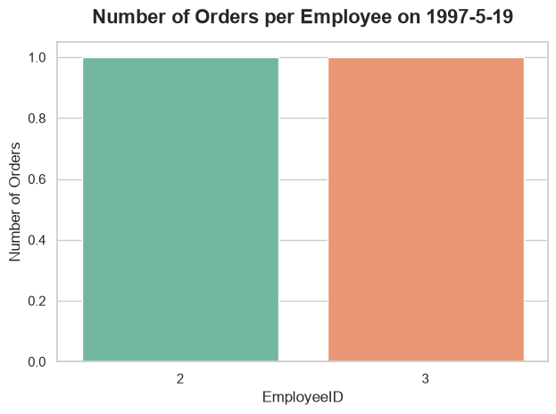
1
Employee Orders on a Single Day
What was the volume and distribution of orders processed by employees on May 19, 1997?
select * from Orders
where OrderDate = '1997-05-19';
OUTPUT
OrderID | CustomerID | EmployeeID | OrderDate | ShippedDate | ShipCountry
10540 | QUICK | 3 | 1997-05-19 | 1997-06-13 | Germany
10541 | HANAR | 2 | 1997-05-19 | 1997-05-29 | Brazil
Only two orders were placed that day — an extremely low-volume day overall.
Workload was split evenly between Employee 2 and Employee 3.

Slide 4
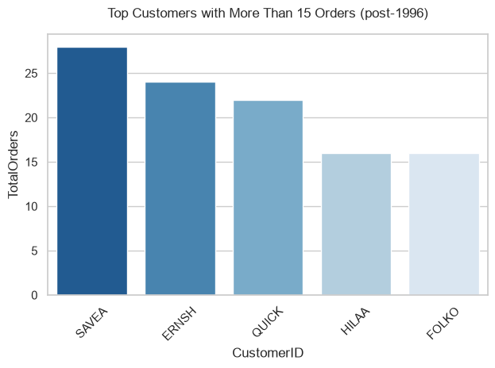
2
Top Customers (VIP)
Who are our most loyal, high-volume (VIP) customers who placed more than 15 orders since the start of 1997?
SELECT CustomerID, COUNT(OrderID) AS TotalOrders
FROM Orders WHERE OrderDate > '1996-12-31'
GROUP BY CustomerID HAVING COUNT(OrderID) > 15;
OUTPUT
CustomerID | TotalOrders
ERNSH | 24
FOLKO | 16
HILAA | 16
QUICK | 22
SAVEA | 28
SAVEA leads with 28 orders, followed by ERNSH and QUICK.
Recommendation: Target these VIP clients with dedicated loyalty programs and exclusive offers to secure retention.

Slide 5
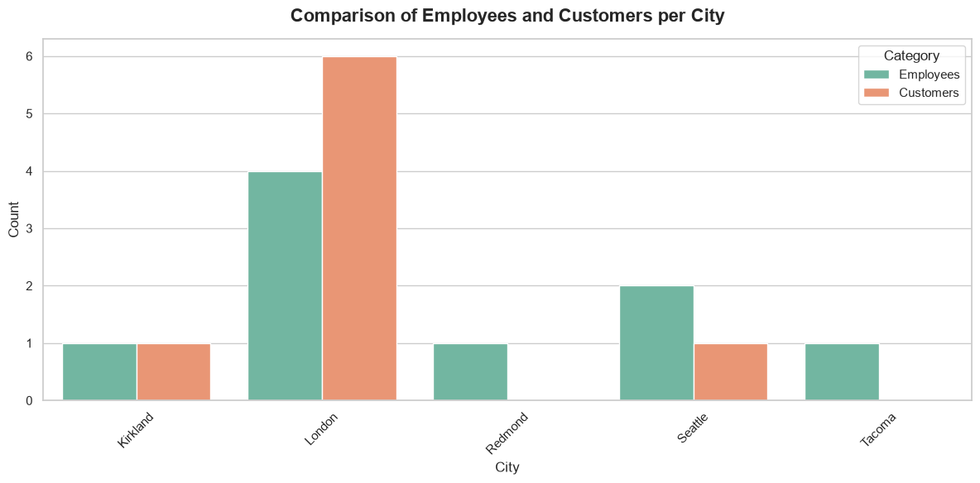
3
Employees vs. Customers by City
How does the geographic distribution of our employees compare to the actual density of our customers across cities?
SELECT E.City,
COUNT(DISTINCT E.EmployeeID) AS Employees,
COUNT(DISTINCT C.CustomerID) AS Customers
FROM Employees E
LEFT JOIN Customers C ON E.City = C.City
GROUP BY E.City;
OUTPUT
City | Employees | Customers
Kirkland | 1 | 1
London | 4 | 6
Redmond | 1 | 0
Seattle | 2 | 1
Tacoma | 1 | 0
Redmond and Tacoma have customers but zero local employees; London is well-staffed.
Recommendation: Relocate staff or hire local reps in high-density customer cities to optimize service.

Slide 6
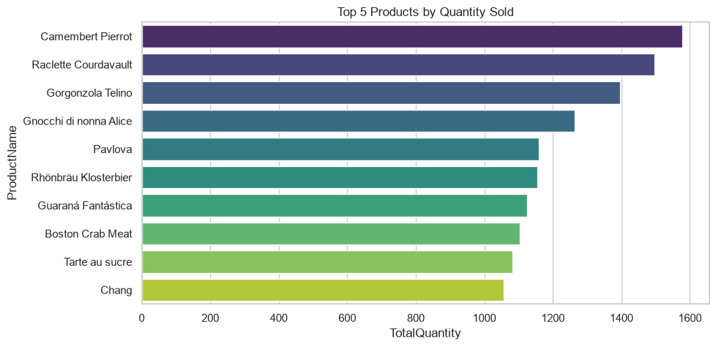
4
Best-Selling Products
Which products generated the highest sales volume in terms of total quantity ordered?
SELECT TOP 10 P.ProductName,
SUM(od.Quantity) AS TotalQuantity
FROM Products P
JOIN [Order Details] od
ON P.ProductID = od.ProductID
GROUP BY P.ProductName
ORDER BY TotalQuantity DESC;
OUTPUT
ProductName | TotalQuantity
Camembert Pierrot | 1577
Raclette Courdavault | 1496
Gorgonzola Telino | 1397
Gnocchi di nonna Alice | 1263
Pavlova | 1158
… 5 more rows (10 total)
Camembert Pierrot tops the list, ahead of Raclette Courdavault and Gorgonzola Telino.
Recommendation: Keep consistent stock levels for these top products to prevent stockouts and maximize revenue.

Slide 7
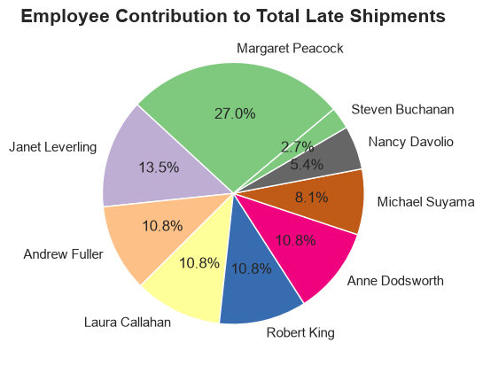
5
Employees and Late Shipments
Which employees recorded the highest number of late shipments, where the shipped date exceeded the required date?
SELECT Orders.OrderID,
Employees.FirstName, Employees.LastName
FROM Orders
INNER JOIN Employees
ON Orders.EmployeeID = Employees.EmployeeID
WHERE Orders.ShippedDate > Orders.RequiredDate;
OUTPUT
OrderID | FirstName | LastName
10264 | Michael | Suyama
10271 | Michael | Suyama
10280 | Andrew | Fuller
10302 | Margaret | Peacock
10309 | Janet | Leverling
… 32 more rows (37 total)
Margaret Peacock accounts for 27% of all late-shipped orders — the largest share by far.
Recommendation: Use this to find bottlenecks in specific shipping routes or logistics workflows.

Slide 8
Summary & Recommendations
Strengthen loyalty programs for VIP customers to secure retention.
Rebalance employee locations to match customer density.
Keep stable inventory for the best-selling products.
Address the root causes of delay for the slowest-shipping employees.
Thank You

